Slide 1

A
Project
SURAKSHA
Safety at Your Fingertips - Anytime, Anywhere, Everyone
Team members:

Slide 2
PROBLEM STATEMENT:
Personal safety is a growing concern—girls face harassment, boys encounter threats, and the elderly or kids can’t always call for help and many more problems.
Current solutions like pepper spray or phone apps fail when speed and discretion are critical. Victims often can’t communicate their situation effectively.
Data: Over 50% of assault victims don’t get help in time due to delayed alerts (source: NCRB, 2022).
Imagine a student(Boy/Girl) walking home late, feeling unsafe. Last year, India reported over 300,000 crimes against women alone. What if one device could call for help discreetly?
But in many cases, help comes too late, or never at all.
No network, no one nearby, no tools to defend or call for help, and people also suffer from natural disasters like floods, earthquakes, and many more in these situations, leaving people unable to call for help.
What if just one click could change that? That’s Suraksha.
Suraksha: The Next Generation of Personal Safety and let’s build a safer tomorrow — together.

Slide 3
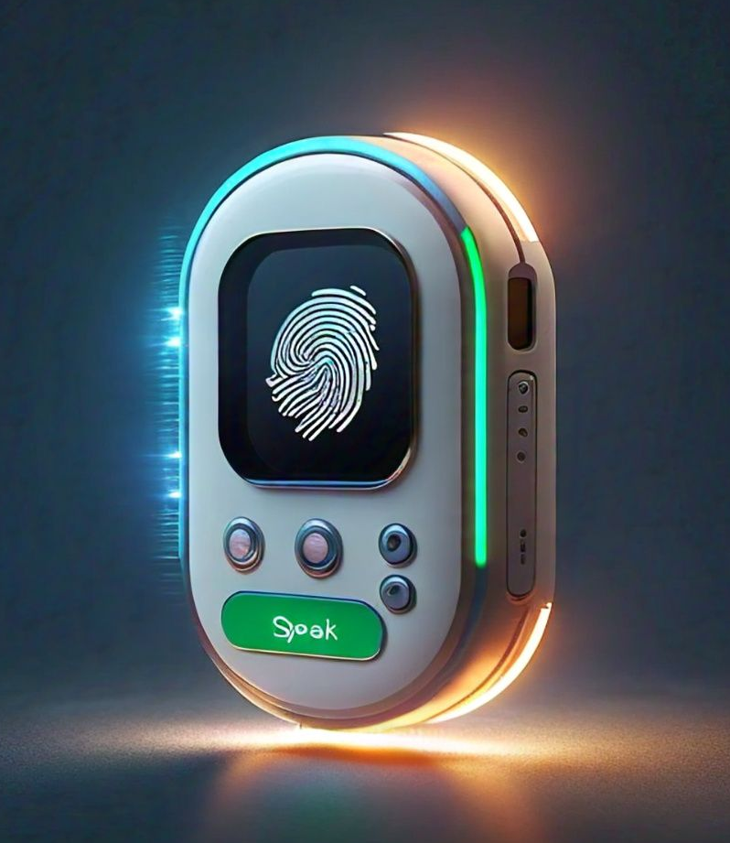
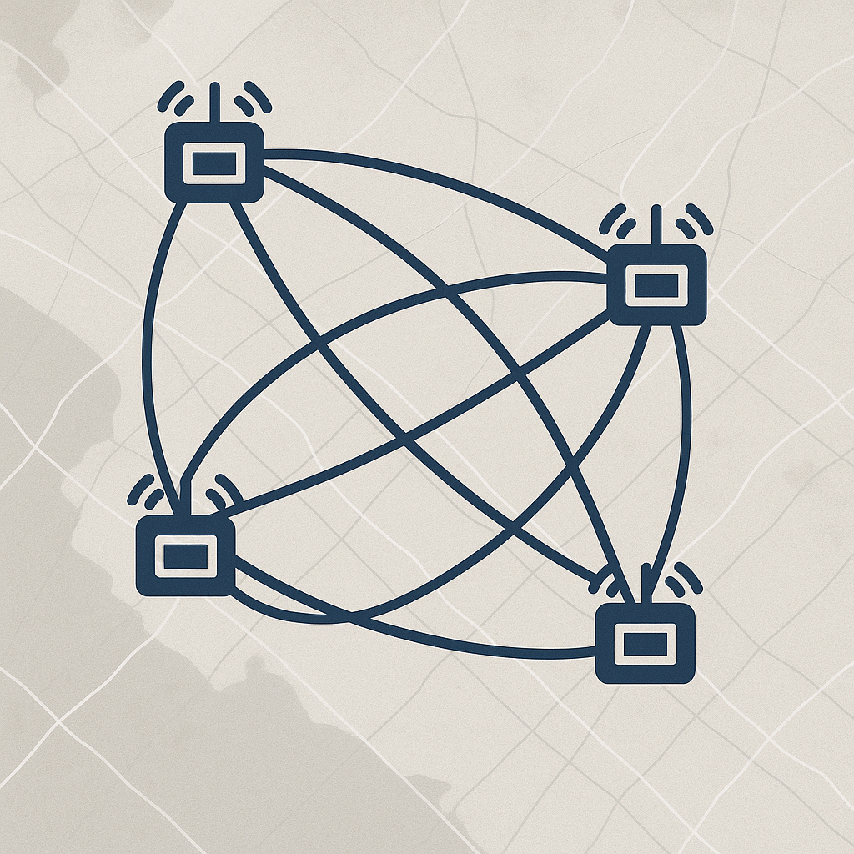
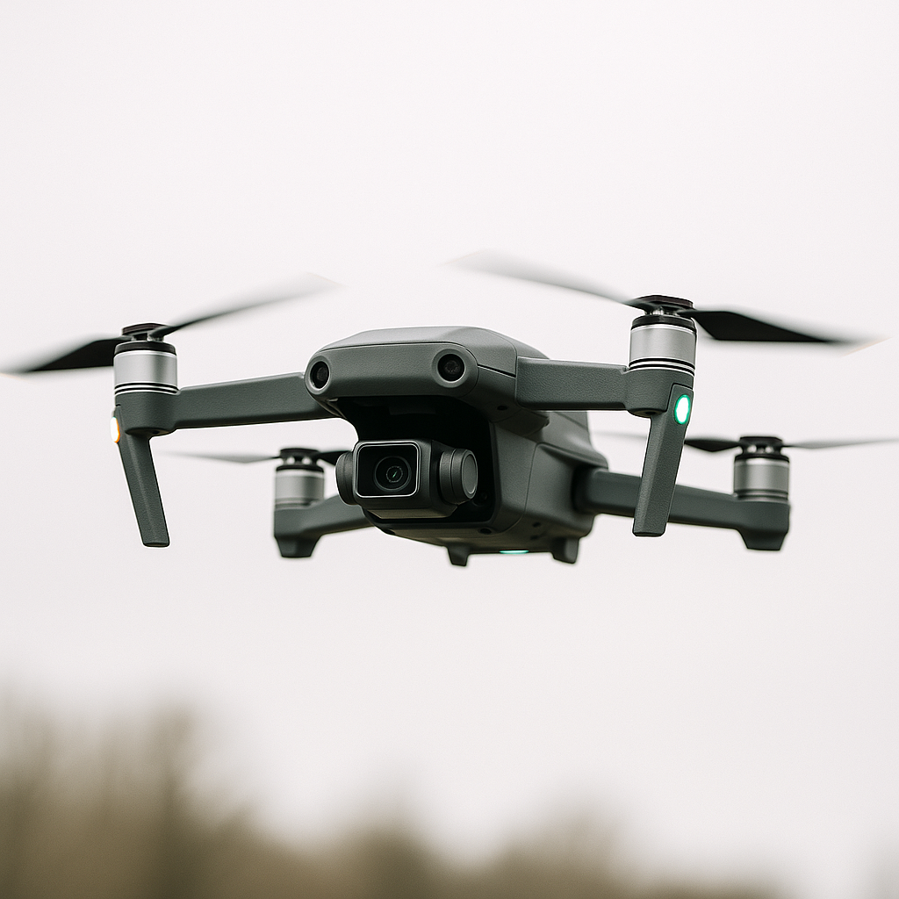
Our Solution:
Suraksha is a 3-part smart rescue system to building a life-saving ecosystem:
1. Suraksha 1.o (A personal device with emergency buttons to perform tasks.)
2. Suraksha Hub (A hub that connects even without internet and forms a Mesh-Network .)
3. Suraksha Smart-Drone ( A drone that comes to help when you're in danger and also work defences for safety)
Suraksha Hub (mesh network)
Suraksha Smart-Drone System
Suraksha 1.O
This is not just an idea — it's a lifeline.

Slide 4
Market Opportunity:
Target customers: Urban/rural citizens, colleges, corporates, Disaster Response Teams (Government and NGOs).
Market Size: Billions globally (especially in countries like India where women’s safety and disaster response are major concerns).
Growth Trends: Surge in personal safety tech, smart cities, LoRa expansion, and drone automation.
We're building the future of safety.
People want real protection, not just an app.

Slide 5
Product (or Demo):
key features & Unique Features:
Multi-mode alerting (SMS, WhatsApp, Email, Phone).
Offline messages send using LoRa
Community Alert Network
Two-Way Communication
Prioritizing Response Levels
Self-defense mechanisms(stun gun mechanizam,High intensity LED)
Crowd-sourced Safety Map
AlertZone
Emergency Mode Lock
Send Recorded Voice File with alert message
Safe-Authorization:Fingerprint access
Smart Drone System:automation/aumated Drone
SkyDefender:Drone
Trace-Guard
Customization of devices Features based on your habits/ other factors

Slide 6
Product (or Demo):
Technology Stack:
Software & programming: For website : Django(python) -Backend, Html,Css,Javascripts -Frontend, For Device: C++,Python, Cloud Platform.
Hardware:
For suraksha 1.O (personal safety device): ESP32 NODE MCU, Fingerprint sensor, Led lights(white,blue,green,red), Push buttons/other type button, GPS Module , LoRa Module, Microphone, Speaker, Battery(3.7V, 2000mAh LiPo battery or a similar capacity Li-ion battery,), Charging module, Boost converter, Resistors, zerno diode ,male and female cables(extra).
For Suraksha-Hub(mesh-Network): ESP32-S3 Devkit(built in wifi), EN(28)60 Ethernet module/SIM800L GSM module ,LoRa module SX1276, NEO-M8N GPS module, Power supply(5v,2A), 3s 2000mah lipo battery, Lipo charging module, Power switch circuit, Antenna(915 mhz),Miscellaneous(wiers,connector,pcb,etc..).
For Suraksha Smart-Drone: Raspberry pi 4 (full kit), Pixhawk 2.4.8 flight controller, S500 quadcopter Frame, Brushless motors- 2122 1000kv, ESCs -30A BCHeli (4x), Propellers-9*4.5-inch (4x), GPS module, Lipo battery 6S 30,000MAH, Power distribution board(PDB) , Raspberry pi cemera module v2 , Optional(Flysky Fs-i6 Transmitter & Recevier) , HC-SR04 ulterasonic sensor (4x), Extra wires,monts.

Slide 7
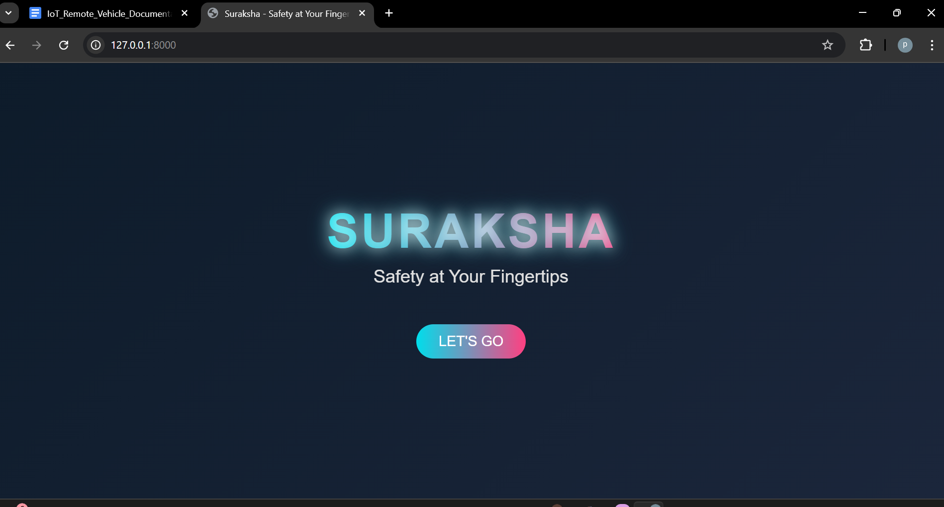
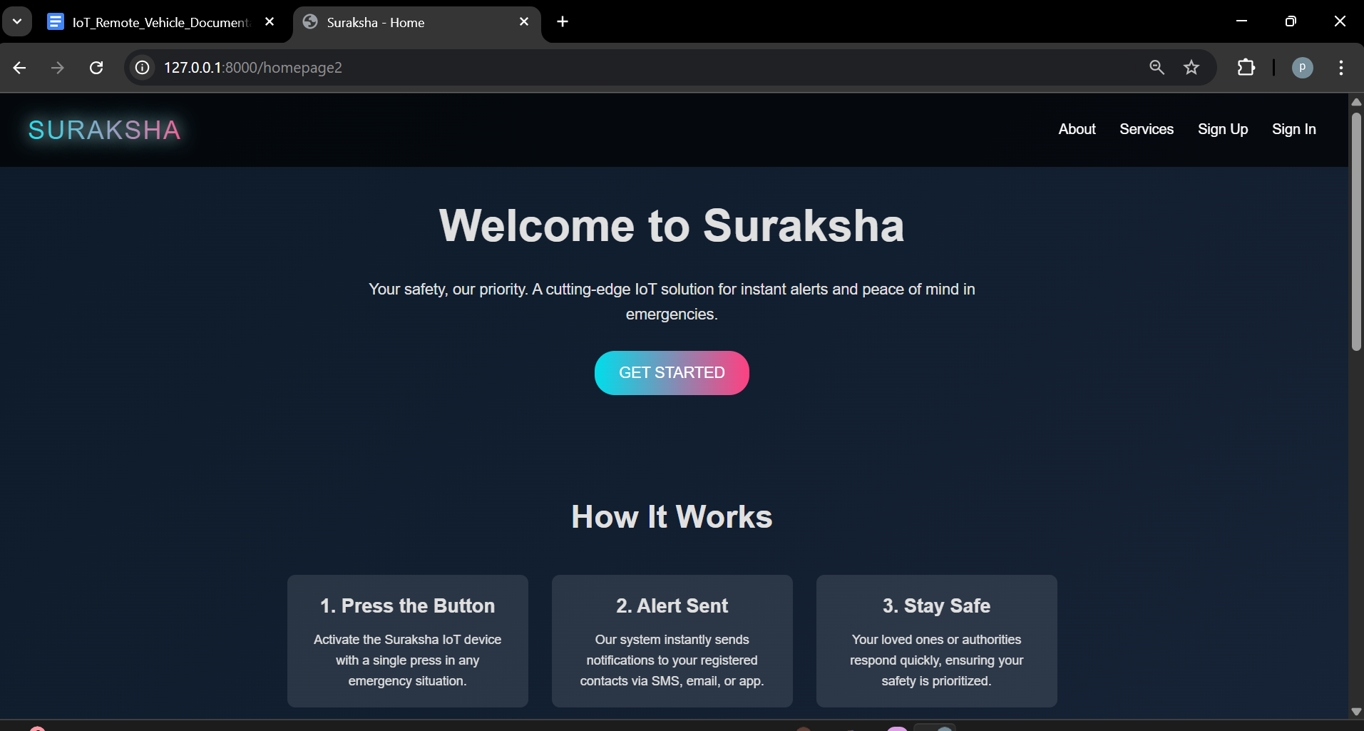
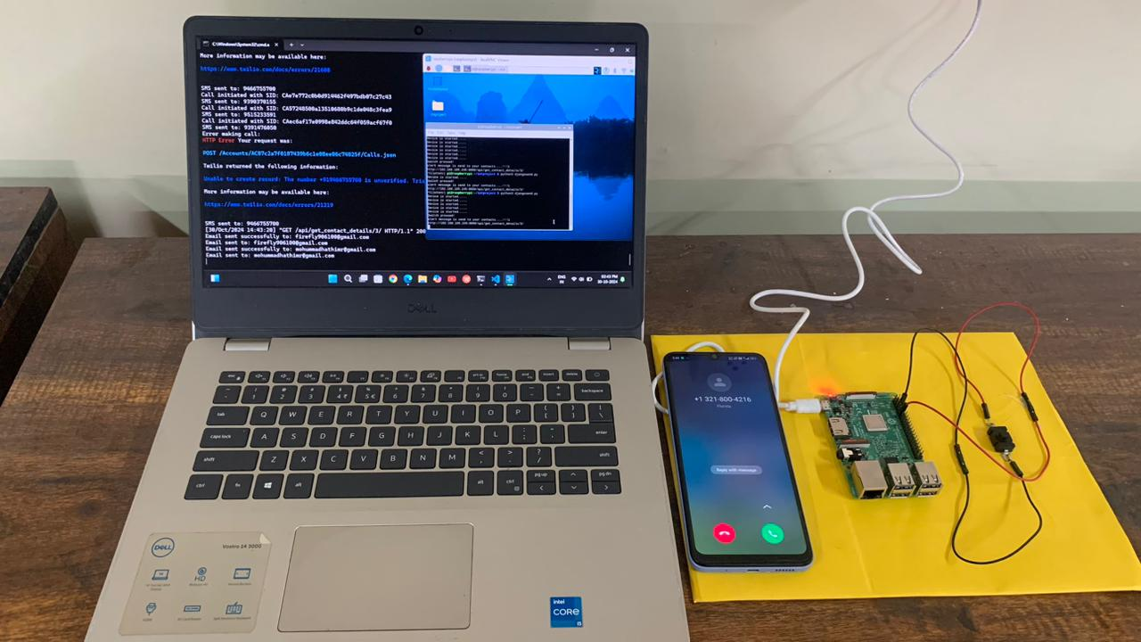
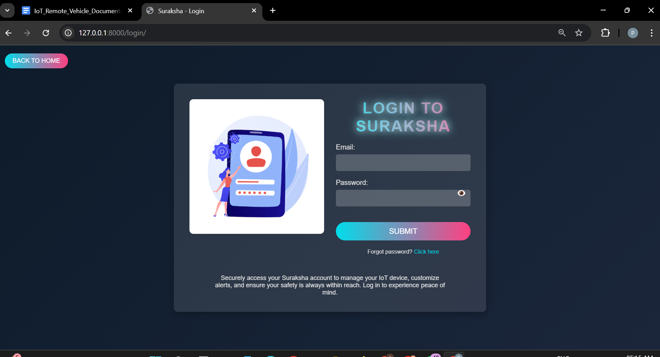
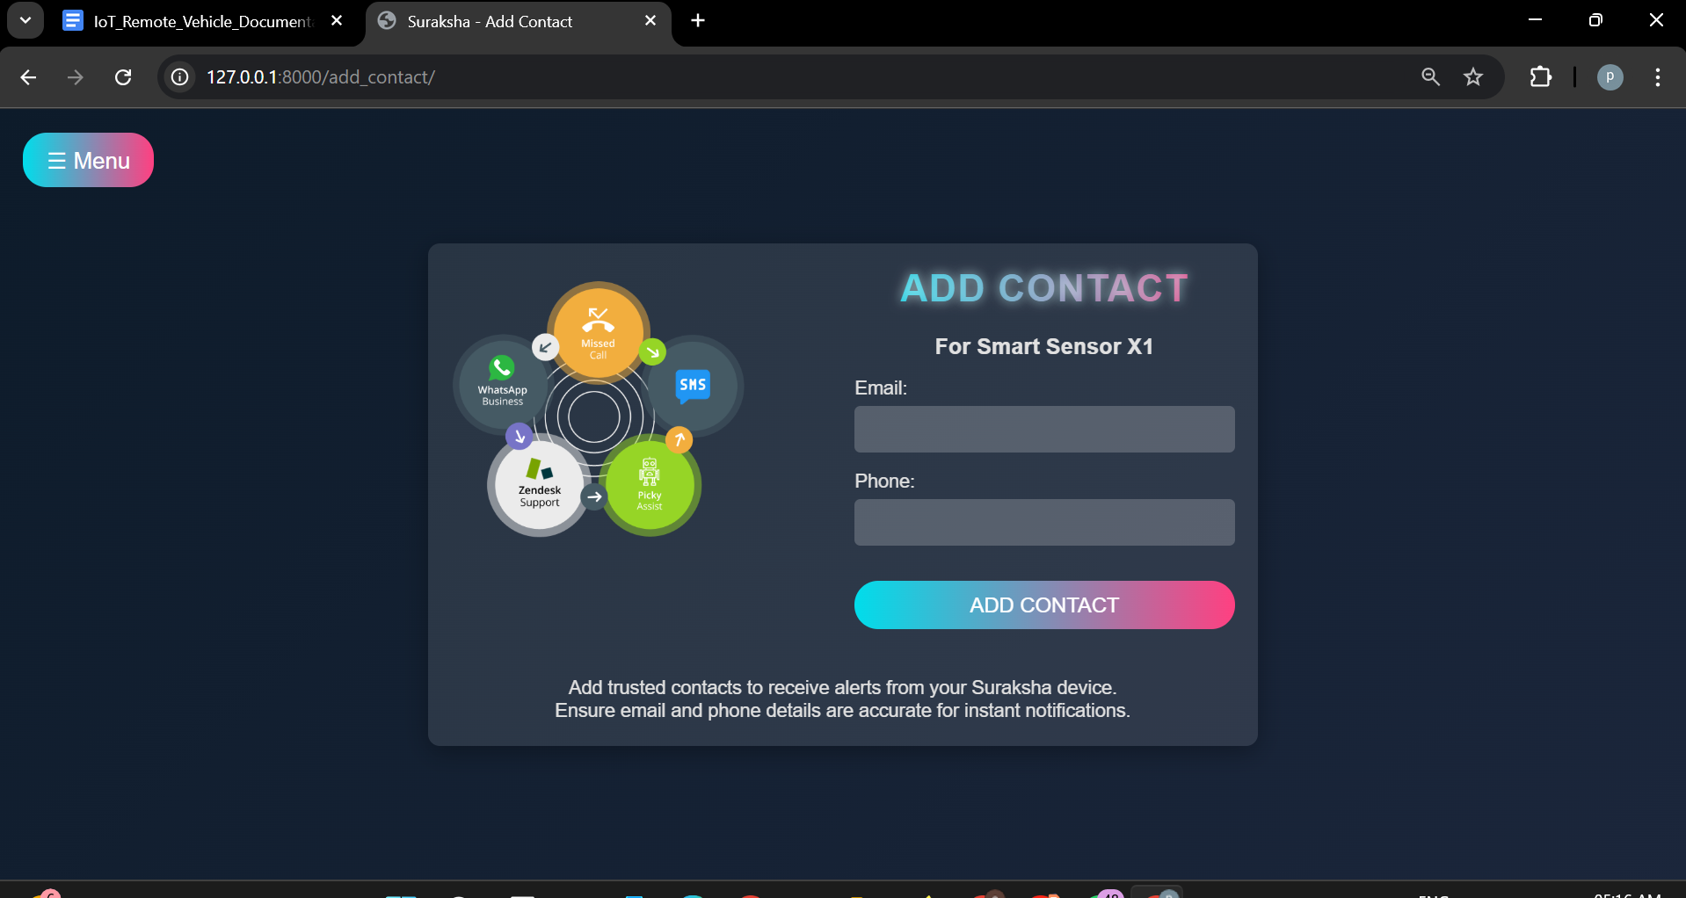
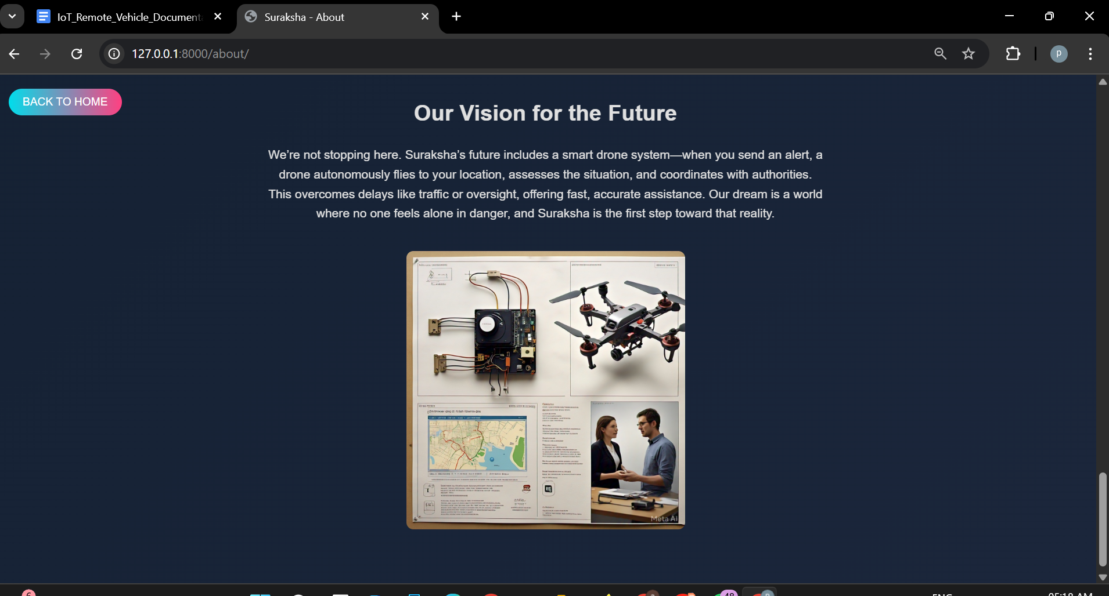
Product (or Demo) -Sample Pics
Phase-1 Prototype-image
Interface page
Home page
Suraksha Login page
Adding an contact to device
Future Plan
Demo vedio:
https://drive.google.com/file/d/1xOLJ5F2IMrX82LyiJe_atNx6BA6rXrBu/view?usp=sharing

Slide 8
Business Model:
Revenue Streams:
Device sales (1-time)
Subscription for premium features (cloud storage, drone services, smart alerts) or Premium Plan
B2B deals with schools, housing societies, municipalities ans espcially with Government
Pricing: Based on cost of device development and services
Maintenance & Upgrades:
We’ll provide regular firmware updates, hardware support, and options to upgrade sensors or software modules based on user needs.

Slide 9
Go-To-Market Strategy:
To successfully bring our innovation to market, we’re adopting a phased strategy:
Start with universities and hostels.
Partner with local police and safety orgs., and Government.
Social media + community outreach.
Run campaigns in cities and online.
Word of mouth will follow — safety spreads fast.

Slide 10
Competitive Landscape:
Others: Smart wearables, panic buttons, SOS apps, and smartwatches.
But none can work without internet, or fly a drone to save you.
We’re the only one doing all of this in one system.
Our Edge: Drone intervention + LoRa offline alerts + multi-channel alerts + self-defense + real-time video.
How different we are:
We offered Octa-Unique Features to save lifes when ever user in unsafe or any danger situation.
Features like Offline messages send using LoRa, Community Alert Network, Two-Way Communication, Prioritizing Response Levels, Self-defense mechanisms(stun gun mechanizam,High intensity LED), Crowd-sourced Safety Map, AlertZone, Emergency Mode Lock, Send Recorded Voice File with alert message and so on.
Because tech should not just connect people — It should protect them.

Slide 11
Traction & Customer Validation:
Website + backend already under development.
Building working prototype.
Here our Suraksha solution is planed in 5-Phase, so for web just build phase one that can send alert messages via various platform(sms,whatsapp,email,phone call) with gps and audio files, but due less resoures we made this so far
we tested our phase-1 suraksha 1.O with almost 20+ students in our college we got good feedback.
Together, let’s create a world where safety is accessible, smart, and compassionate for everyone.

Slide 12
Team Suraksha:

Slide 13
Ask / Call to Action:
Need: Mentorship, Beta Testers, Initial Seed Funding (₹5L)
Next Step: Complete full prototype + launch pilot in campus.
Support: Connect us to safety organizations, provide feedback, join our mission.
We're looking for mentors, beta testers, Funds and support to take our prototype to the next level.
Why Suraksha?
Because safety is not a privilege. It’s a right.
Let’s build a safer tomorrow — together.

Slide 14
“This isn’t just a product. It’s a guardian. A silent protector. A second chance when every second counts. With Suraksha, safety isn’t just a hope. It’s a promise.” -Suraksha
We sincerely thank the ISF team, our mentors, and everyone who believes in empowering young innovators to create meaningful change.
Your support has not only guided us — it has inspired us to dream bigger, build better, and strive to protect lives through technology.
Together, let’s create a world where safety is accessible, smart, and compassionate for everyone.
We are grateful for the opportunity to share our vision with you.
Let’s build a safer tomorrow — together.
Our Contact:
akulashivaakulashiva@gmail.com & yashwanthmogudala5@gmail.com
Thank You

Slide 15
THANK YOU…

